Slide 1


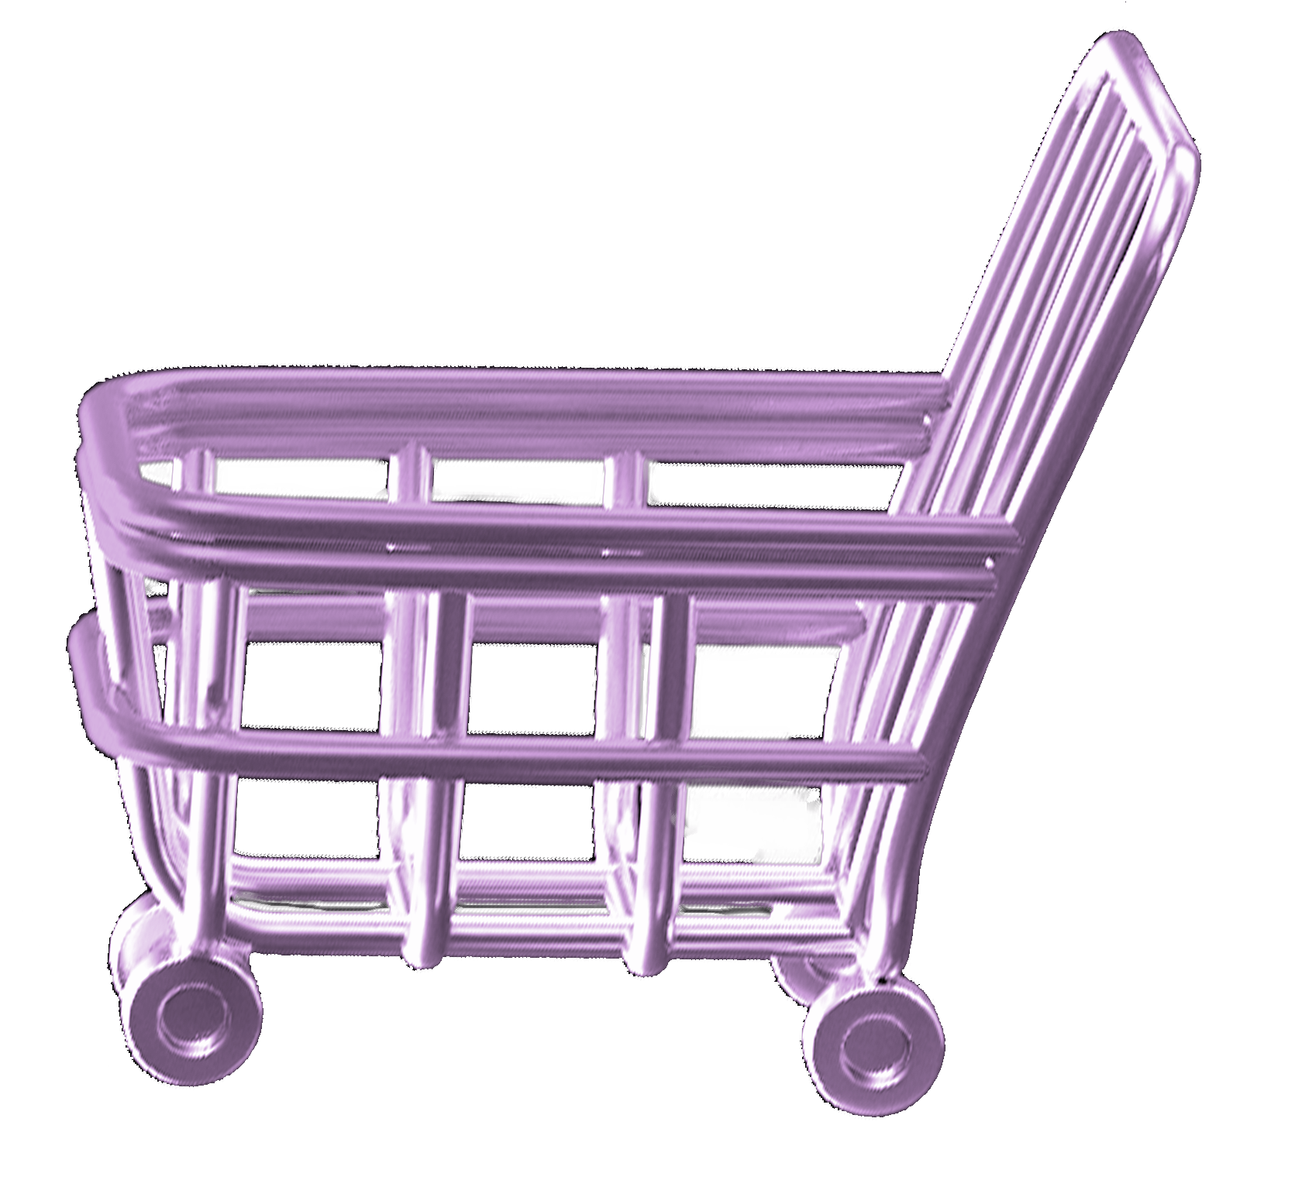
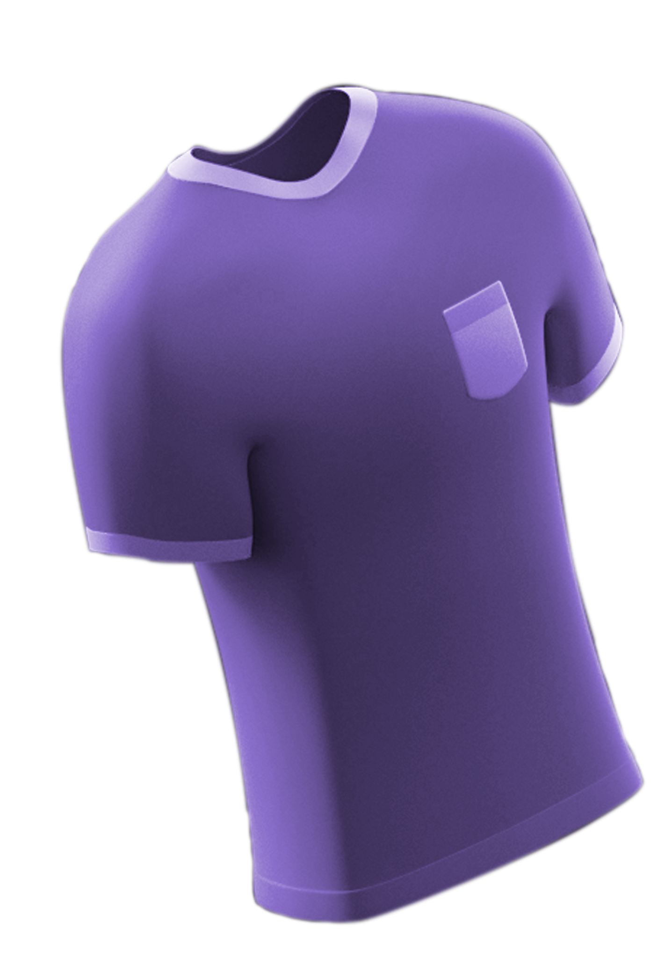
First Person Online Shopping
Anarhie: Alexandru Calciu,
Claudiu Mogodeanu,
Andrei Petrea

Slide 2
Introduction
The world is swiftly heading towards the online domain and the authenticity of in-store shopping is fading away.
Our main goal is to keep a glimpse of the old-school shopping experience

Slide 3
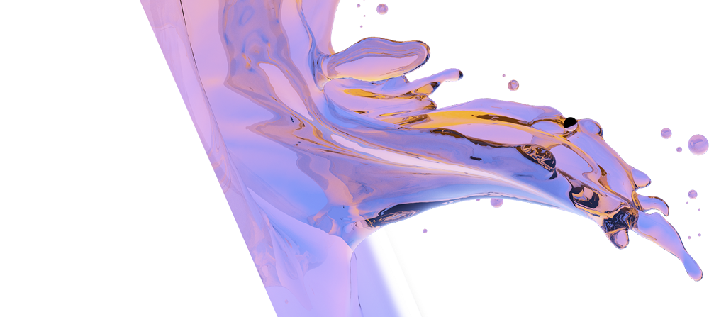
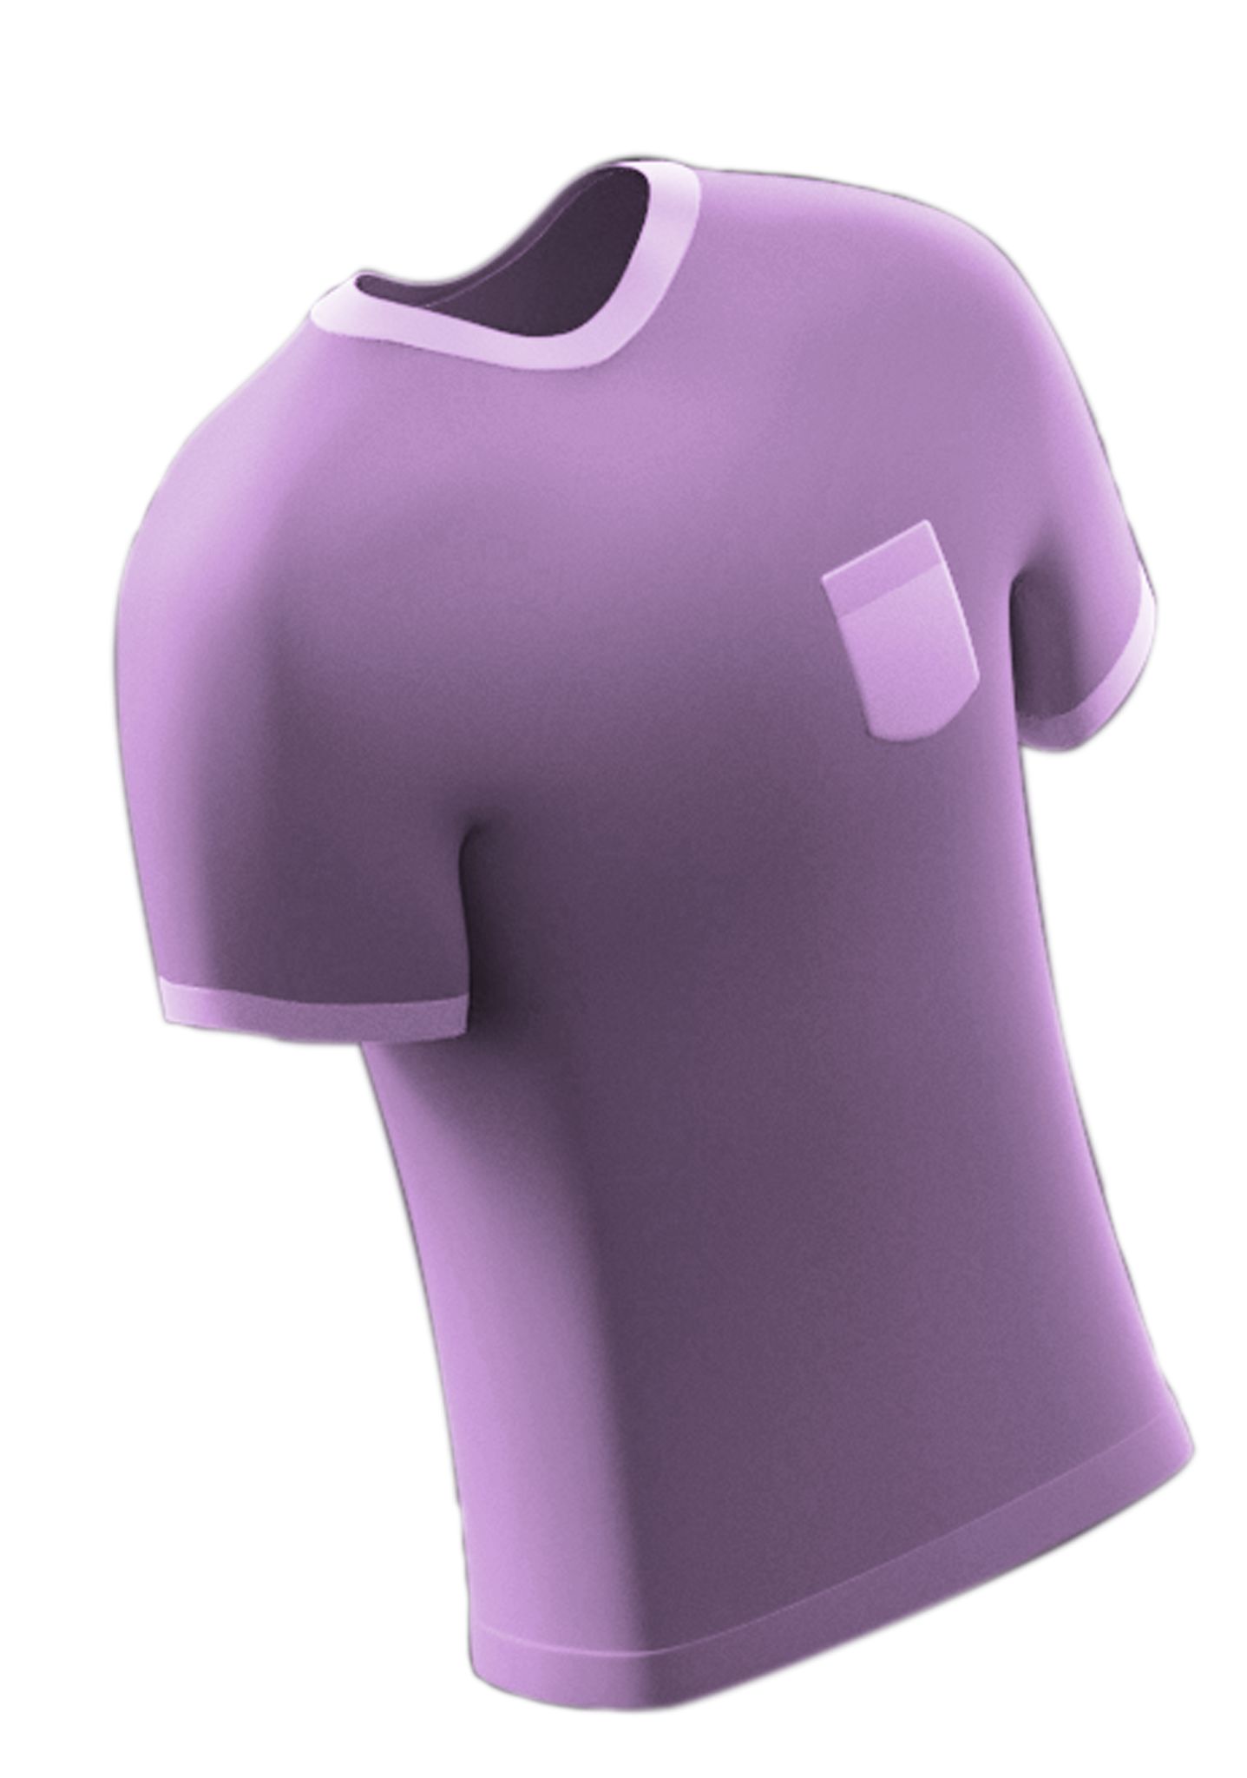
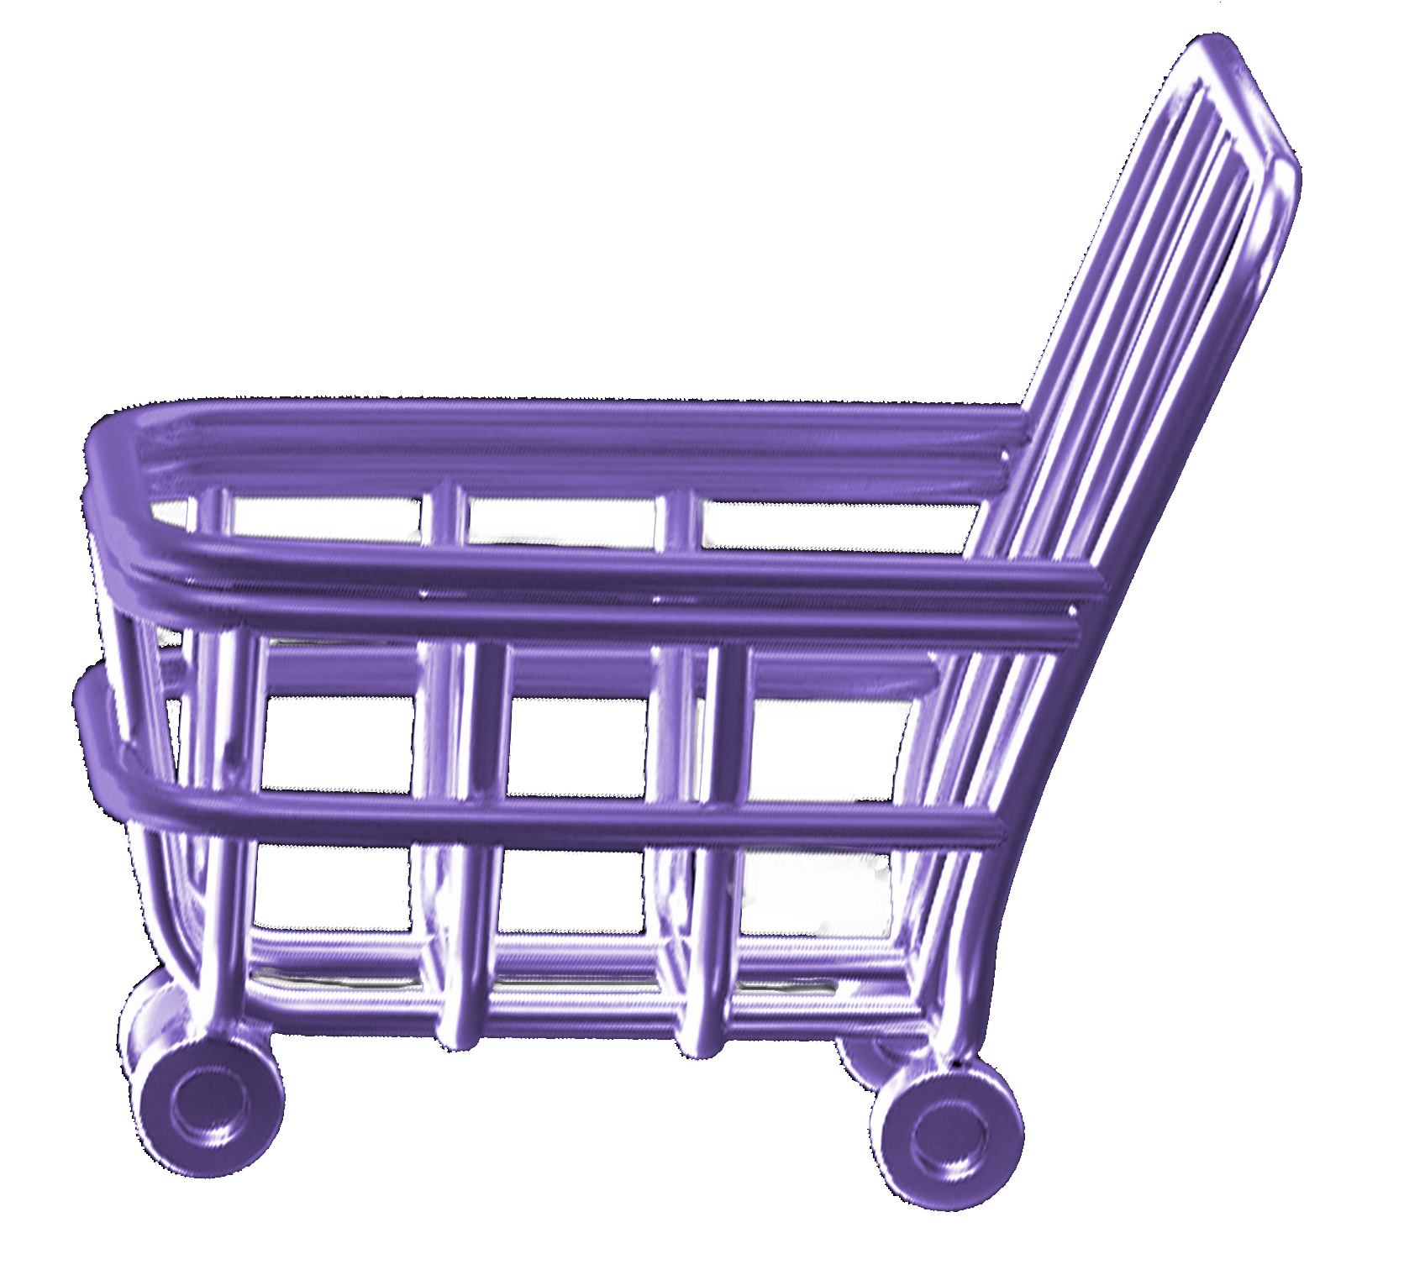
Main feature
We generated a virtual environment meant to emulate the feeling of shopping in a real store

Slide 4
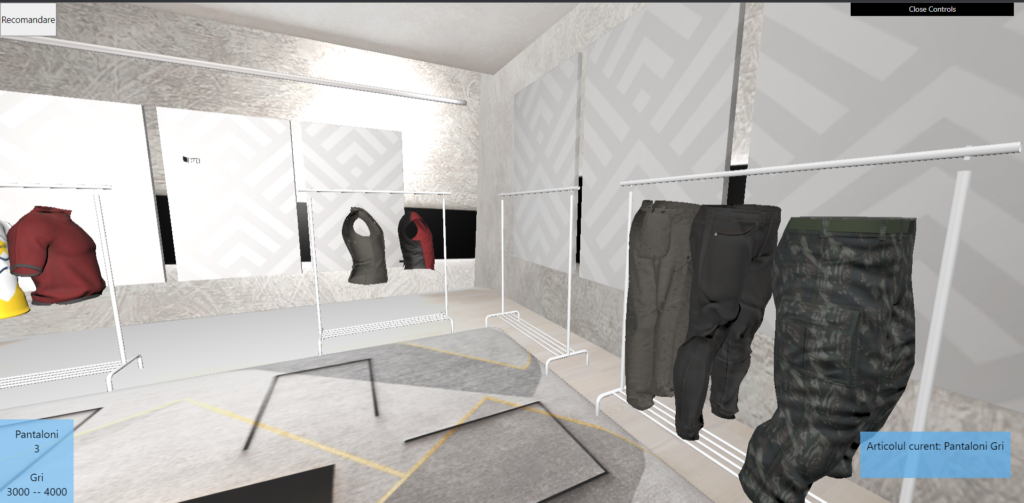

Slide 5
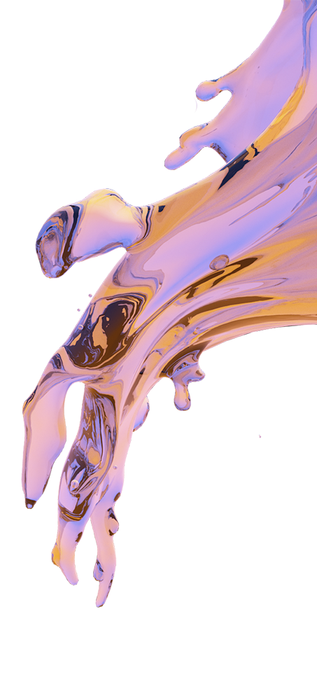
Innovation
Our simulation enables us to recommend products to our customers, by observing their behaviour in the virtual shop, specifically counting how much time they spent looking at the showcased items.

Slide 6
Technologies used
Three.js
Tensorflow
Flask
GLTF
T
T
Used for rendering the scene
Used for training the neural networks behind the recommendation system
F
G
Used for creating a minimal server for our application
The preferred file format for our assets

Slide 7
Machine Learning and Neural Networks
We implemented and trained several neural networks that allow us to generate the recommended price, size and colour for the products that our customers may be interested in.
We made use of the Tensorflow and Keras libraries and their built-in functions
The neural networks have been trained for several hundred generations, based on a training set of 5000 products and what a person bought afterwards.

Slide 8
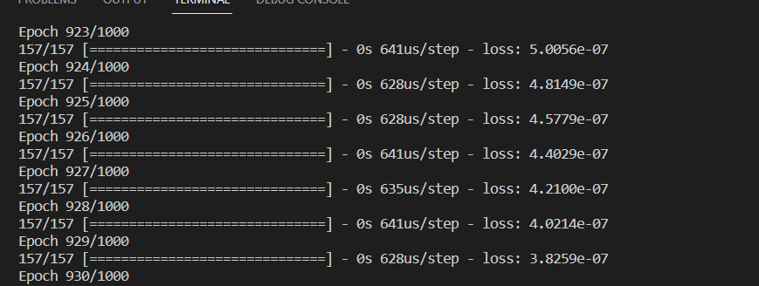

Slide 9
The Bond Between
Inside the browser app, we are counting how much time the customer spent near a specific item, the latter also being showed on the screen.
The times are received as a JSON after a GET request and, when the user presses the recommendation button, the obtained data are parsed and sent as input to the neural networks, thus leading to some suggestions
Consequently to a POST request to the server, the details of a product are showcased on the screen.
All the on-screen pop-ups will change according to the FOV of the user and how the time was spent overall.

Slide 10
THANK YOU!

